Slide 1
Building Single Page Applications in SharePoint Using AngularJS
Steve Pietrek
Cardinal Solutions Group

Slide 2

Steve Pietrek
Cardinal Solutions
App Dev Practice Manager
SharePoint Application Architect
Front End Developer
Raleigh/Durham
Contact
@spietrek
spietrek@cardinalsolutions.com
Presentation References
http://jsfiddle.net/spietrek/VKbpu/2
https://github.com/spietrek/Cardinal.Projects
https://github.com/spietrek/SharePointCincy

Slide 3
Agenda
SPA Overview
AngularJS Overview
SharePoint Development Challenges
SharePoint Data Access
Tools
Projects Demo
Deployment
Best Practices & Gotchas

Slide 4
Single Page Applications

Slide 5
Single Page Applications
Goal: Provide a desktop-like feel
Entire site content loads within a single page
Only areas of the site will reload based on user actions
Main technologies: HTML, CSS, JavaScript, AJAX, web services (e.g. REST)
Presentation layer can be completely decoupled from backend layer

Slide 6
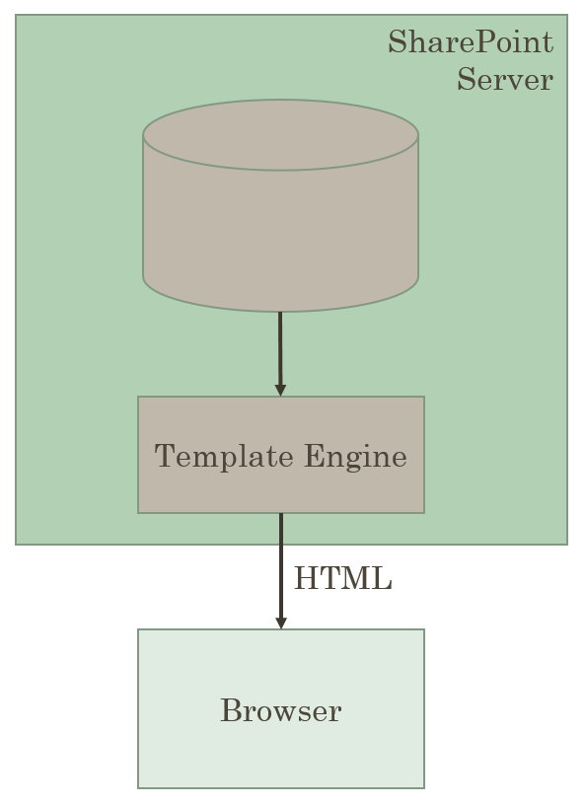
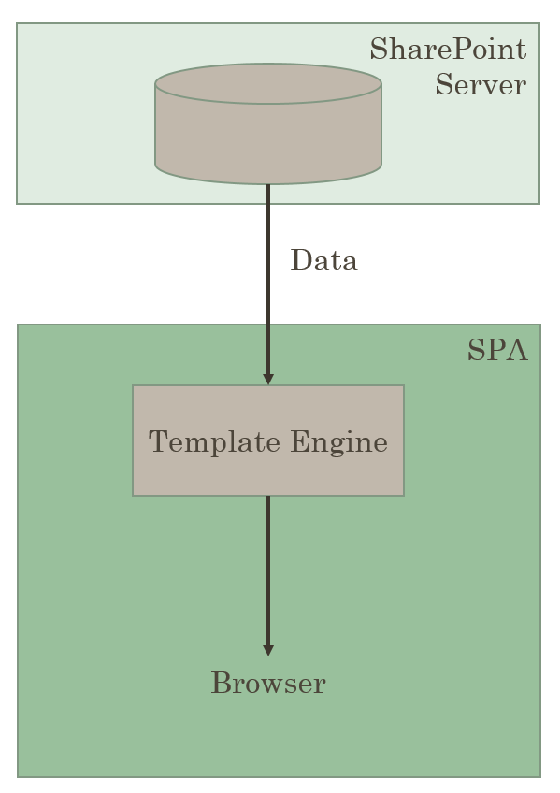
Traditional vs. Single Page Application

Slide 7
AngularJS Overview

Slide 8
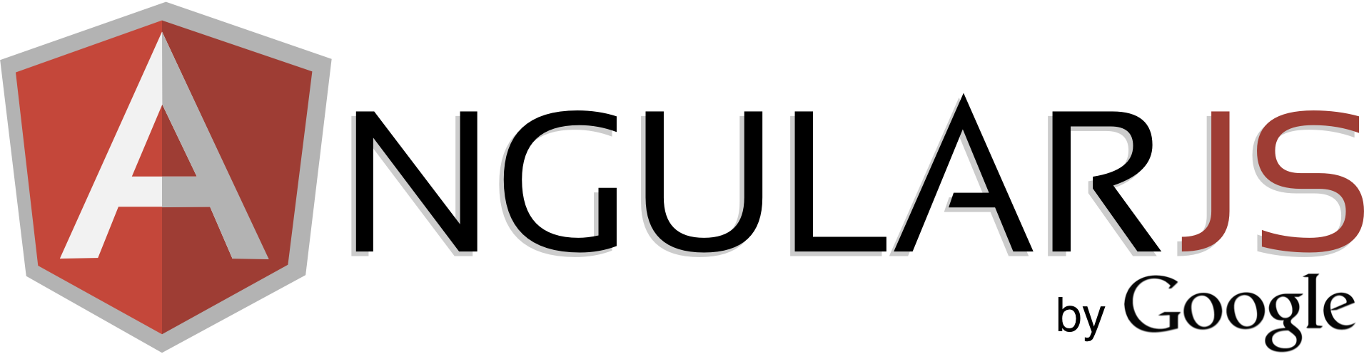

Slide 9
AngularJS Main Features
Backed by Google
MV*
Dependency Injection
Testing
jqLite
Templates
Modules
Controllers
Filters
Providers
Form Validation
Routing
Two-way Data Binding
Directives
Great for SPA’s

Slide 10
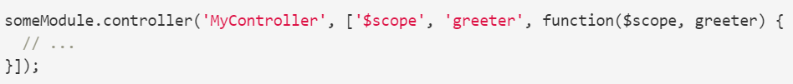
Dependency Injection
Design pattern in which an object is given its dependencies, rather than the object creating them itself
Separate the process of creation and consumption of dependencies
Provides an easy way to change dependencies if needed
Key to making easily testable components (i.e. mock objects)
Important: Use Inline Array Annotation (especially when minifying code)

Slide 11
Modules
Organize your code – similar to .NET namespaces
Code is more maintainable, testable, and readable
Create modules for dependencies using DI
Includes multiple Controllers, Filters, Directives, and Providers
Module
Config
Controllers
Filters
Directives
Routes
Factories
Services
Providers
Values
Constants

Slide 12
ng-app
Directive to bootstrap an Angular application
<html ng-app="app">
Only one ng-app per page
Need more than one … manually bootstrap
angular.bootstrap(document.body, ['app']);

Slide 13
Scope
POJO that refers to the application object
Scopes can watch expressions and propagate events
Think of Scope as a View Model in MVVM
Expressions
<h5>Search Term: {{demo.name}}</h5>
Watches are used to watch for scope changes:
$scope.$watch("firstName", function(value) {
//do something with value…
});

Slide 14
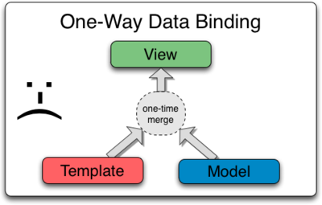
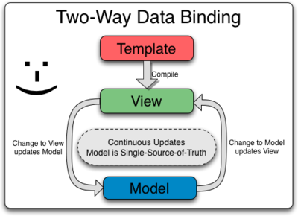
Data Binding
Create complex objects.
Bind in one direction (merge).
Change to Model is not updated in View (and vice versa).
Additional code is required to keep Model and View in sync.
Use POJO’s.
Template is compiled into a “live view”.
Changes to View or Model are kept in sync.
The “glue” is $scope.

Slide 15
Controllers
Use to:
Set the initial state of $scope (i.e. Scope Container)
Add behavior to the $scope object (i.e. business logic)
Controller as helps with testing
Follow Single Responsibility Principle (SRP) to aid in testing
Do not use to:
Manipulate the DOM. Use data binding or directives.
Communicate between controllers. Use services.
Filter objects. Use filters.

Slide 16
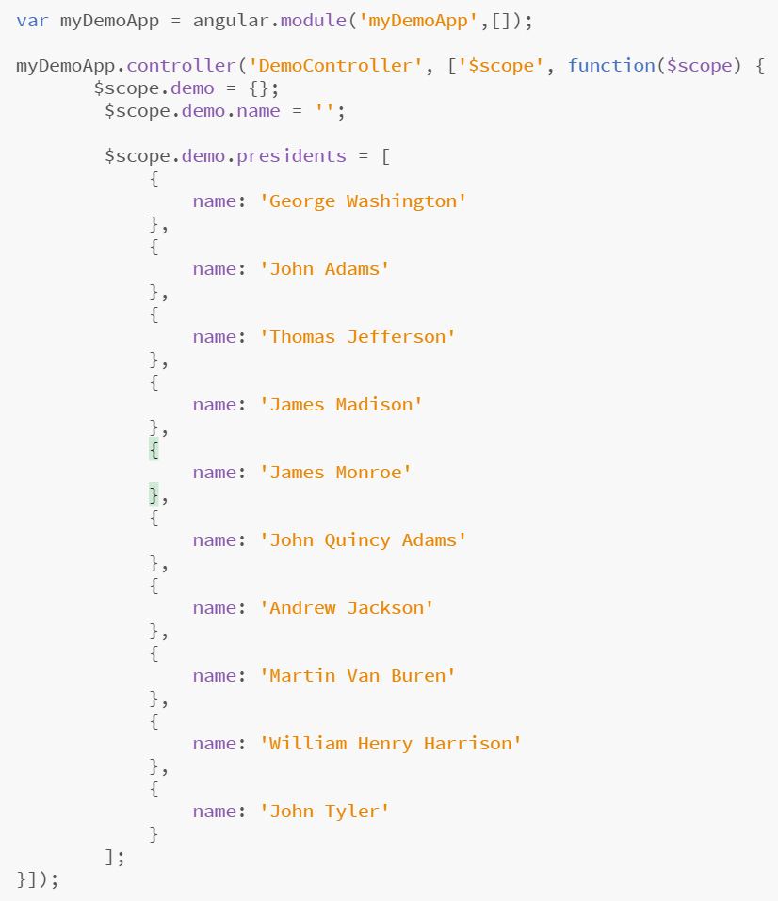
Controllers
Controller
Module
Dependency Injection
Scope

Slide 17
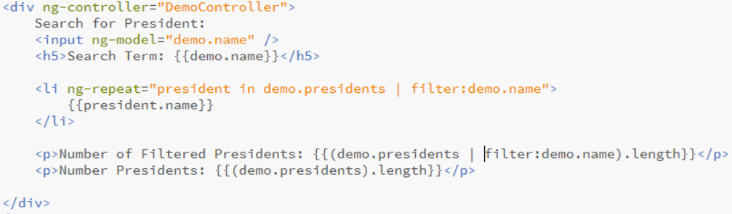
Data Binding
Directive
Directive
Filter
Directive
Expression
Expression
Expression
Expression
Filter

Slide 18
Filters
Formats the value of an expression displayed to users
OOTB examples include:
currency, date, filter, json, limitTo, lowercase, number, orderBy, uppercase
Chain multiples using |
Create custom ones as well
ng-repeat="president in demo.presidents | orderBy:'name'"
ng-repeat="president in demo.presidents | filter:demo.name"
<li ng-repeat="president in demo.presidents | filter:demo.name">
{{president.name | uppercase}}
</li>

Slide 19
AngularJS Demo http://jsfiddle.net/spietrek/VKbpu/2/

Slide 20
Providers
Keep data around for lifetime of application
Separation of concerns
Singleton objects
Logical place to access external data ($http or $resource)
Preferred method to communicate between controllers
Many out-of-the-box services (e.g. $http)
Constants
Value injected anywhere
Values
Simple injectable value
Factories
Injectable function
Services
Injectable constructor
Providers
Configurable factory
Notes:
http://blog.xebia.com/2013/09/01/differences-between-providers-in-angularjs/

Slide 21
Directives
Many out-of-box directives (e.g. ng-app, ng-repeat, ng-model, ng-controller, etc.)
Allow you to extend HTML vocabulary for your application
HTML annotations that trigger JavaScript behaviors
Extend attributes, elements, classes, or comments
Function that runs when the compiler encounters it in DOM
DISCLOSURE: Most complex area in AngularJS. Important to learn for code reuse and separation of concerns.

Slide 22
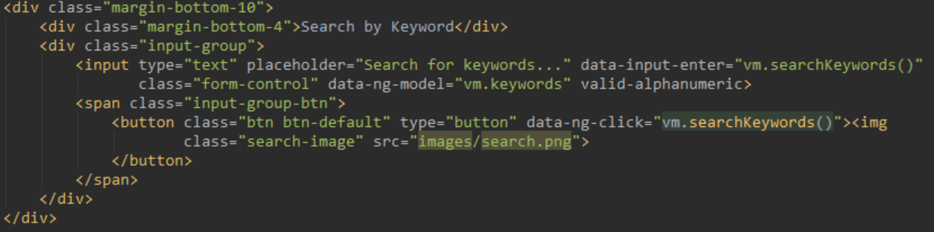
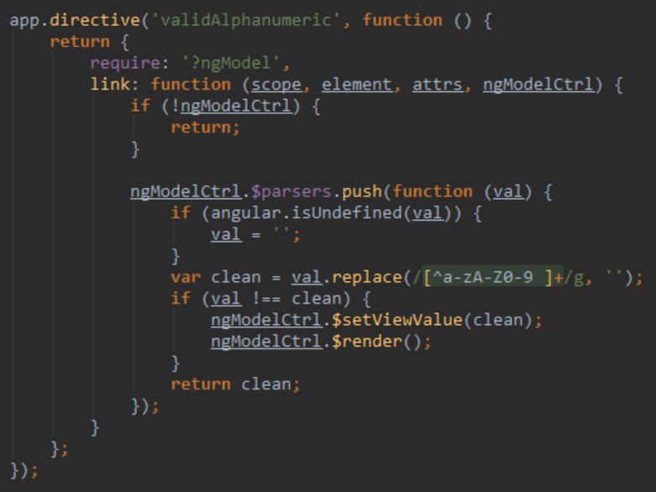
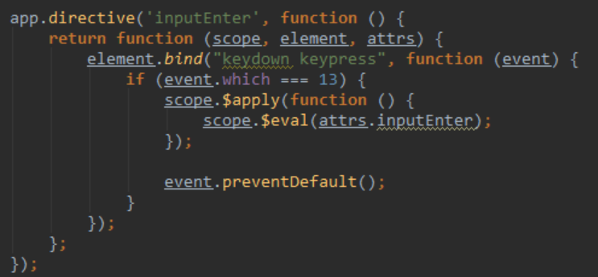

Slide 23
SharePoint Development Challenges

Slide 24
SharePoint 2007 Challenge
Full Trust applications
Code affects the whole farm
Developers build custom solutions
Administrators can only secure solutions with Code Access Security (CAS)
Hard to control what is in custom code (e.g. Elevated Privileges)
Biggest cause of SharePoint support cases: Custom code
Developer
Administrator
Site Collection Owner
Activate and use customizations
Design, build, and test customizations
Install and monitor customizations

Slide 25
SharePoint 2010 Challenge
Developer
Administrator
Site Collection Owner
Install customizations
Design, build, and test customizations
Set quotas and monitor customizations
Activate and use customizations
Sandbox solutions applications
Code affects the site collection
Developers build custom solutions
Administrators define quotas and use resource monitors to check site collection usage
Site collection owners deploy, activate, and implement the customizations
Missing functionality in Sandbox Solutions

Slide 26
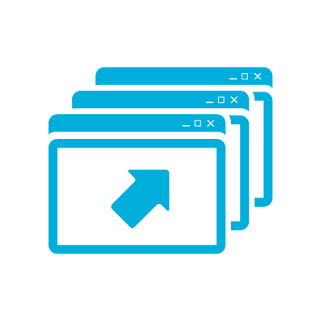
SharePoint Development Challenges
Performance and Stability
Lifecycle Management
Not Cloud Ready
Resources
Notes:
Challenges
Difficultly finding qualified resources
Steep learning curve
Performance and stability issues
Requires deployment by Farm Administrators
Lifecycle management
Not cloud ready
What is a SharePoint 2013 App?
Web application that runs “OUTSIDE” of SharePoint
Uses Client OM to talk to SharePoint (JS, REST/CSOM)
Is the future proof way to add new capabilities to SP2013+
Is available from the Corporate App Catalog or SharePoint Store
Is easy to install by site owners or Tenant/Farm administrators

Slide 27
Benefits of SharePoint 2013 App Model
Infrastructure
Developers
Users
Isolation & multitenant
Reduces risk to farm
Simplifies SharePoint upgrades
Cloud ready
Corporate App Catalog facilitates governance
Larger developer reach
Use industry standards
Use non-SharePoint technologies
Lifecycle management (development, deployment, versioning, upgrades)
Based on familiar app model
Apps can be downloaded from SharePoint Store or Corporate App Catalog
Notes:
Challenges
Difficultly finding qualified resources
Steep learning curve
Performance and stability issues
Requires deployment by Farm Administrators
Lifecycle management
Not cloud ready
What is a SharePoint 2013 App?
Web application that runs “OUTSIDE” of SharePoint
Uses Client OM to talk to SharePoint (JS, REST/CSOM)
Is the future proof way to add new capabilities to SP2013+
Is available from the Corporate App Catalog or SharePoint Store
Is easy to install by site owners or Tenant/Farm administrators

Slide 28
Benefits of JavaScript
Infrastructure
Developers
Users
Isolation & multitenant
Reduces risk to farm
Simplifies SharePoint upgrades
Cloud ready
Corporate App Catalog facilitates governance
Larger developer reach
Use industry standards
Use non-SharePoint technologies
Lifecycle management (development, deployment, versioning, upgrades)
Quicker development experience
Based on familiar app model
Apps can be downloaded from SharePoint Store or Corporate App Catalog
Notes:
Challenges
Difficultly finding qualified resources
Steep learning curve
Performance and stability issues
Requires deployment by Farm Administrators
Lifecycle management
Not cloud ready
What is a SharePoint 2013 App?
Web application that runs “OUTSIDE” of SharePoint
Uses Client OM to talk to SharePoint (JS, REST/CSOM)
Is the future proof way to add new capabilities to SP2013+
Is available from the Corporate App Catalog or SharePoint Store
Is easy to install by site owners or Tenant/Farm administrators

Slide 29
SharePoint Data Access

Slide 30
SharePoint 2013 Remote API
SharePoint
_api is new alias for _vti_bin/client.svc
Server
Client
REST
OData
(2013)
CSOM
Data Access
JavaScript Library
Silverlight Library
.NET CLR Library
OAuth
Cross-domain Library
Authentication
Remote App
Note: ASMX web services have been deprecated
Notes:
Remote APIs are now a first-class citizen
Search, MMS, User Profile, BCS, et al
User-centric capabilities (no Central Admin-like support)
Client-side object model (CSOM)
REST-based (OData)
OAuth provides an open protocol that enables secure authorization in a simple and standard way.
The cross-domain library is a client-side alternative that lets your app communicate with SharePoint installations in the same internet zone.
Changes from SharePoint 2010
The client.svc service extended with REST capabilities
Allows the ability for SharePoint to be accessible from many devices
client.svc now supports direct access from REST clients
client.svc accepts HTTP GET, PUT, POST requests
Implemented in accordance with OData protocol (OData Spec != SharePoint REST)
Many new API’s
CSOM Extended new APIs
New APIs for SharePoint Server functionality
SharePoint 2013 REST
OData standards
Simple and Easy to Use
Much easier to use than SOAP-based Web service or CSOM
Higher productivity when using JavaScript and jQuery
Test in a browser
Platform agnostic
Better documentation
Each query is submitted with a unique URL
Results can be cached by proxy servers
Chattier than CSOM
SharePoint 2013 CSOM
Collection of libraries that acts as a proxy to the server-side object model
Accessible through client.svc
Calls to client.svc must go through supported entry points (.NET, Silverlight, JavaScript)
Provides more functionality than REST (i.e. filtering on nulls)
Greater learning curve (i.e. CAML queries)

Slide 31
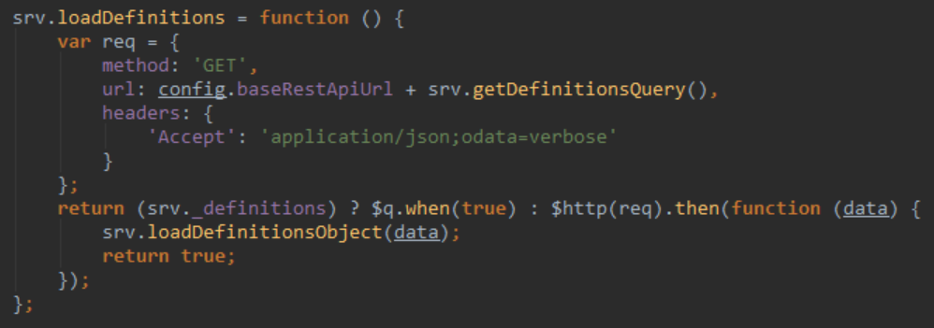
SharePoint 2013 REST
Use jQuery AJAX or AngularJS $http
Best practices
Use Postman or Fiddler to execute, test, and review queries
Set the Accept header
“Chunky, not chatty”

Slide 32
Tools

Slide 33
Tools
IDE: Visual Studio, WebStorm, Brackets, Atom, Sublime Text
Browser Plug-ins: Firebug, Batarang, Postman
Task Runners: Gulp, Grunt
Third-party Frameworks: jQuery, Bootstrap, Moment, DataTables, Font Awesome, SPServices, lodash
Package Managers: npm, Bower
Other tools: Node.js, Fiddler, Karma, Jasmine, PhantomJS

Slide 34
Projects Demo

Slide 35
Deployment

Slide 36
Deployment Workflow
Create Custom Page Layout
Upload Source Code to Pages library
Style and script references
Base HTML referencing ng-app
Consistent folder structure as local environment
Upload source code
SharePoint Deployment
Enable Publishing features
Upload to Master Page Gallery
Update and upload custom page (if necessary)
Upload source code to Pages library
Local Server Test
Gulp tasks
Functional testing
SharePoint Test
Functional testing
Disable web security (--disable-web-security) errors in Chrome

Slide 37
Best Practices & Gotchas

Slide 38
Best Practices
Group by function, not component type
Name your files by function (e.g. projects, dashboard, admin)
Group all files together (module, controllers, services, directives, unit tests, end-to-end tests)
Only one controller per view. Share data between controllers using services.
Organizing code: John Papa’s Angular Style Guide http://goo.gl/xljmi6
Build often!!!
Write unit tests
Test in different browsers

Slide 39
Gotchas
Issue | Workaround
SharePoint Item-limit Threshold | Split data into separate lists or libraries. Add indexes to columns where you want to filter.
SharePoint Security | Apply security at the site or list levels. If possible, avoid item-level permissions. Use Search API to aggregate across sites and lists.
CSS Overrides | SharePoint default CSS may cause style issues. Deploy to SharePoint and test using different browsers. Update CSS to run the same in local environment.
AngularJS Controller Bloat | Use directives to manipulate DOM. Data should be stored in services.
AngularJS Performance | Avoid 2000 watchers on page (may be higher in 1.3). Use Batarang to search for duplication. Use bind once for expressions which do not change.
Dependencies | Review dependencies whenever upgrading tools.
Frameworks

Slide 40
References
https://docs.angularjs.org/guide
http://www.youtube.com/watch?v=i9MHigUZKEM
http://www.youtube.com/watch?v=8ILQOFAgaXE
http://msdn.microsoft.com/en-us/library/office/fp179930(v=office.15).aspx
http://msdn.microsoft.com/en-us/library/office/jj163816(v=office.15).aspx
http://www.jeremythake.com/2014/01/sharepoint-rest-api-to-host-web-with-angularjs-services/
http://goo.gl/xljmi6

Slide 41
Wrap-up / Q&A

Slide 42
SharePoint
Server
SharePoint
Server
Data
SPA
Template Engine
Template Engine
HTML
Browser
Browser

Slide 43
